Slide 1
KS3 Electricity – Lesson 8
Making Electromagnets

Slide 2
Learning Objective
To construct a working electromagnet.
Success Criteria
To recall that when current flows through a wire, a magnetic field is created around the wire.
To carry out an investigation to determine how changing a variable can affect the strength of an electromagnet.
To explain how an electromagnet can be made using a coil of wire and power supply.

Slide 3





Keyword Challenge
Your challenge is to make as many words as you
can from today’s keyword.
electromagnet
How did you do?
10 words or more
8 words or more
6 words or more

Slide 4

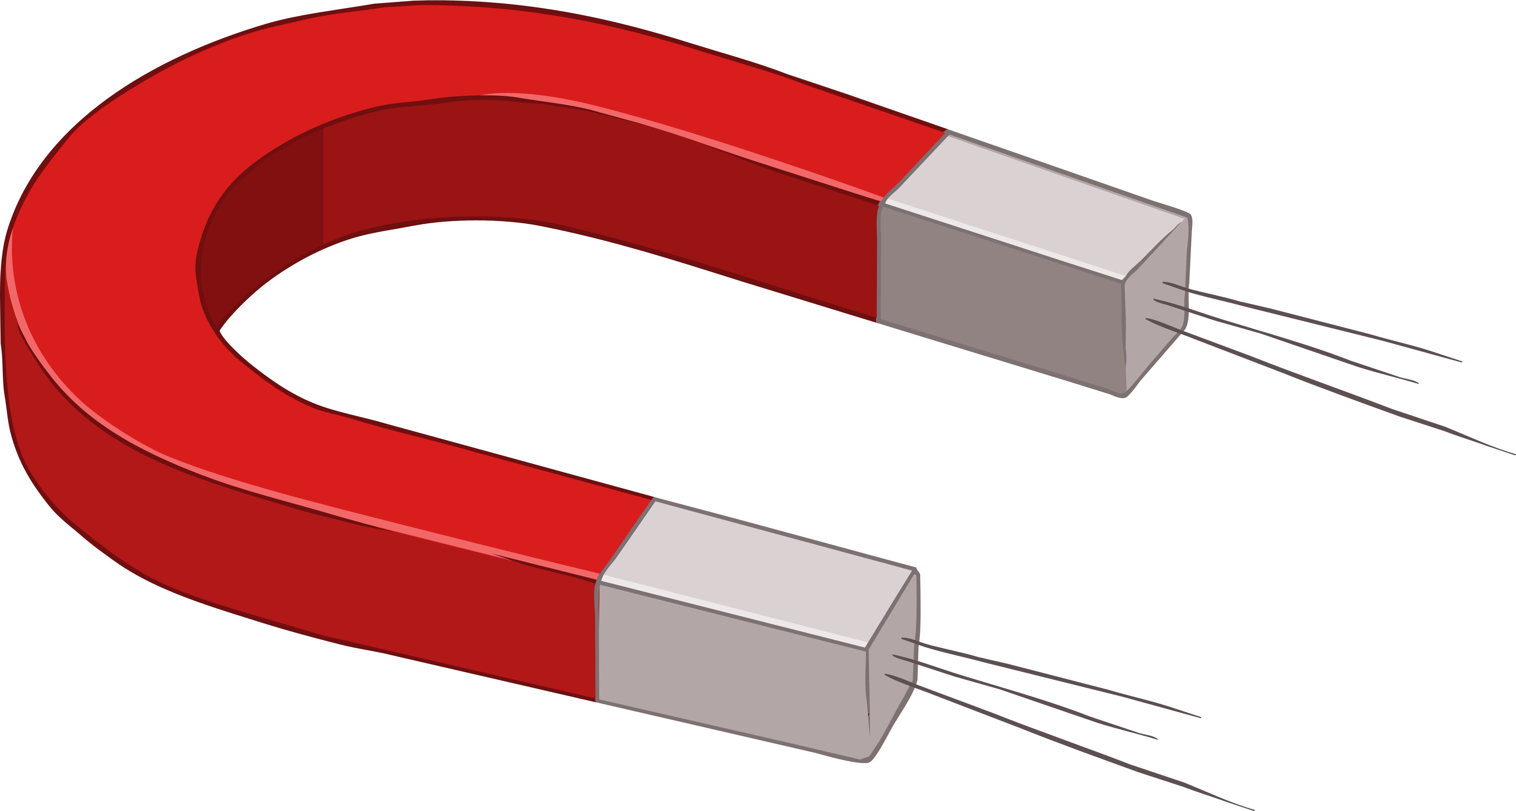
What Do You Already Know
about Magnets?
They can attract some materials.
They can repel other magnets.
They are usually made of iron.
They have two ends called magnetic poles.
One end of the magnet is called the north pole and the opposite end is called the south pole.

Slide 5
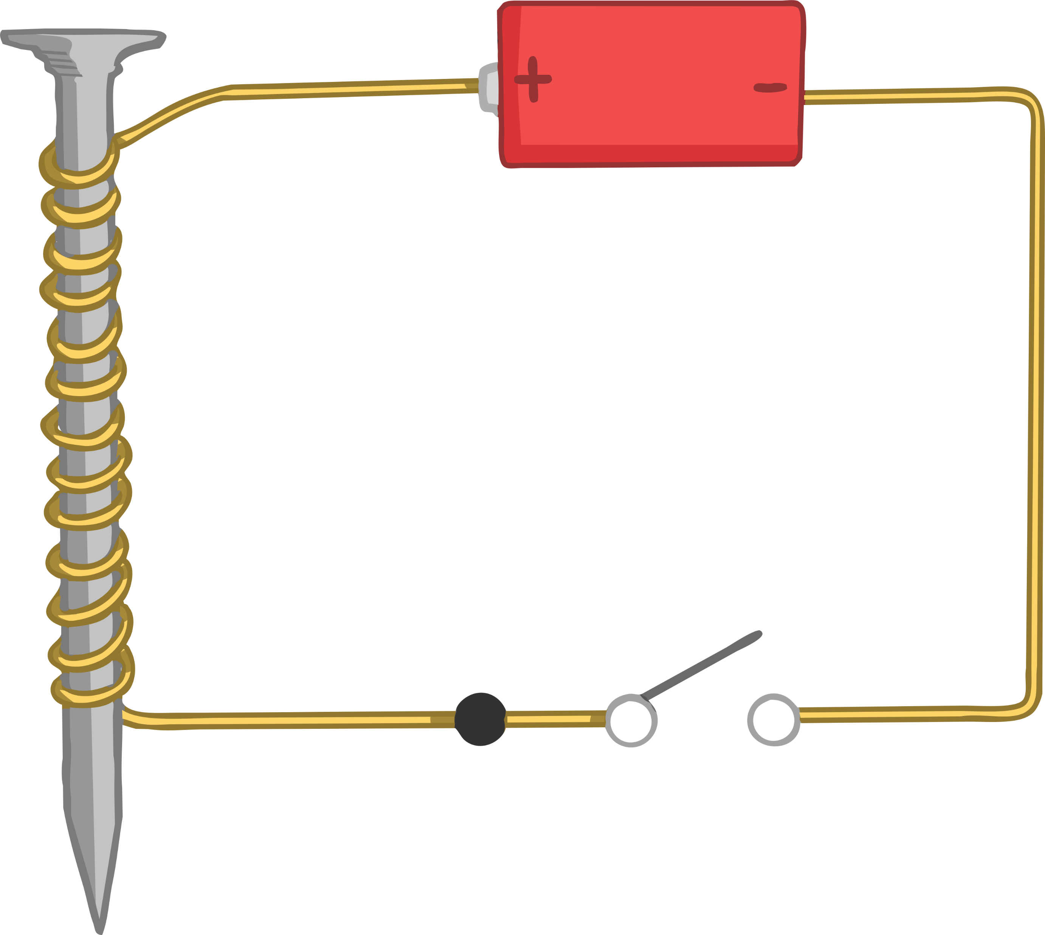
Electromagnets
When electrical charges flow in a wire, a magnetic field is formed around the wire.
The larger the current, the stronger the magnetic field will be.
When a current stops flowing, there is no magnetic field.

Slide 6

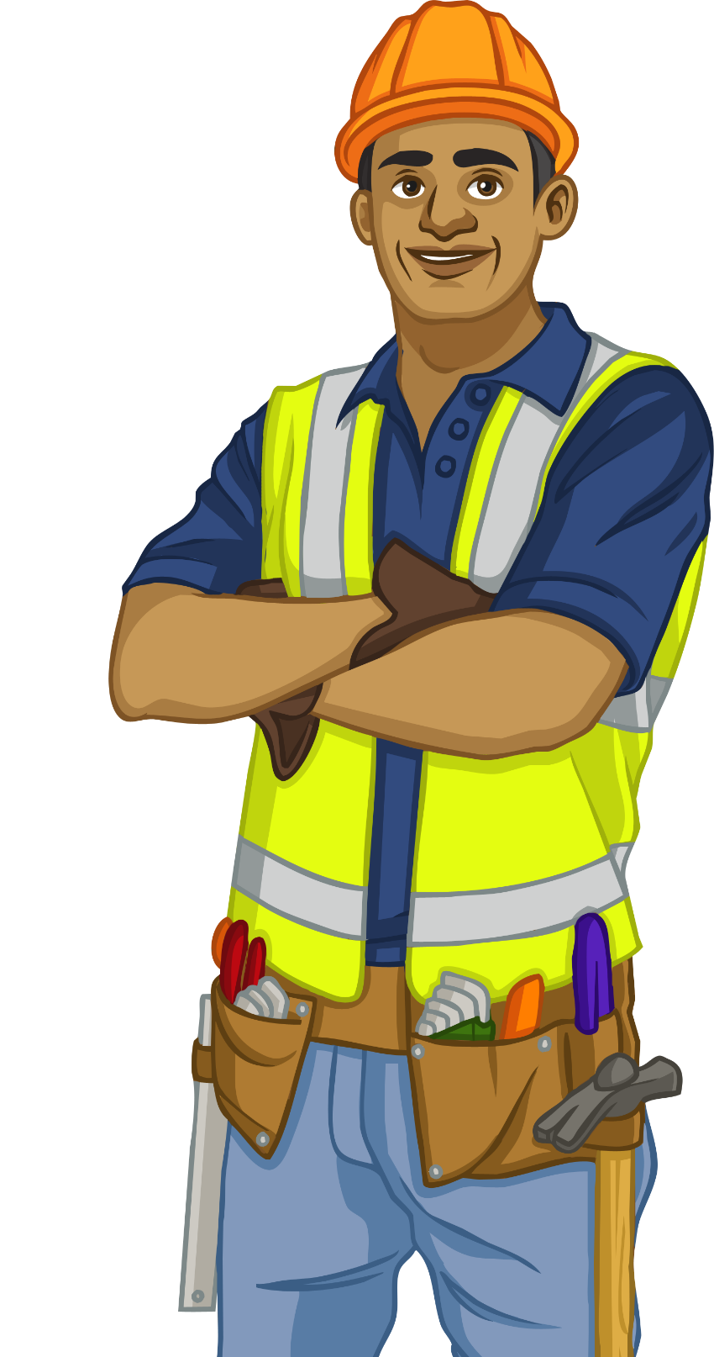
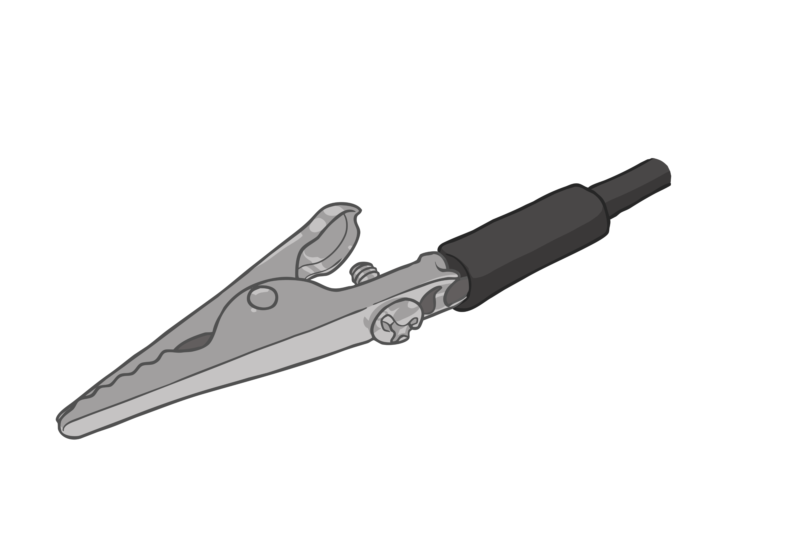
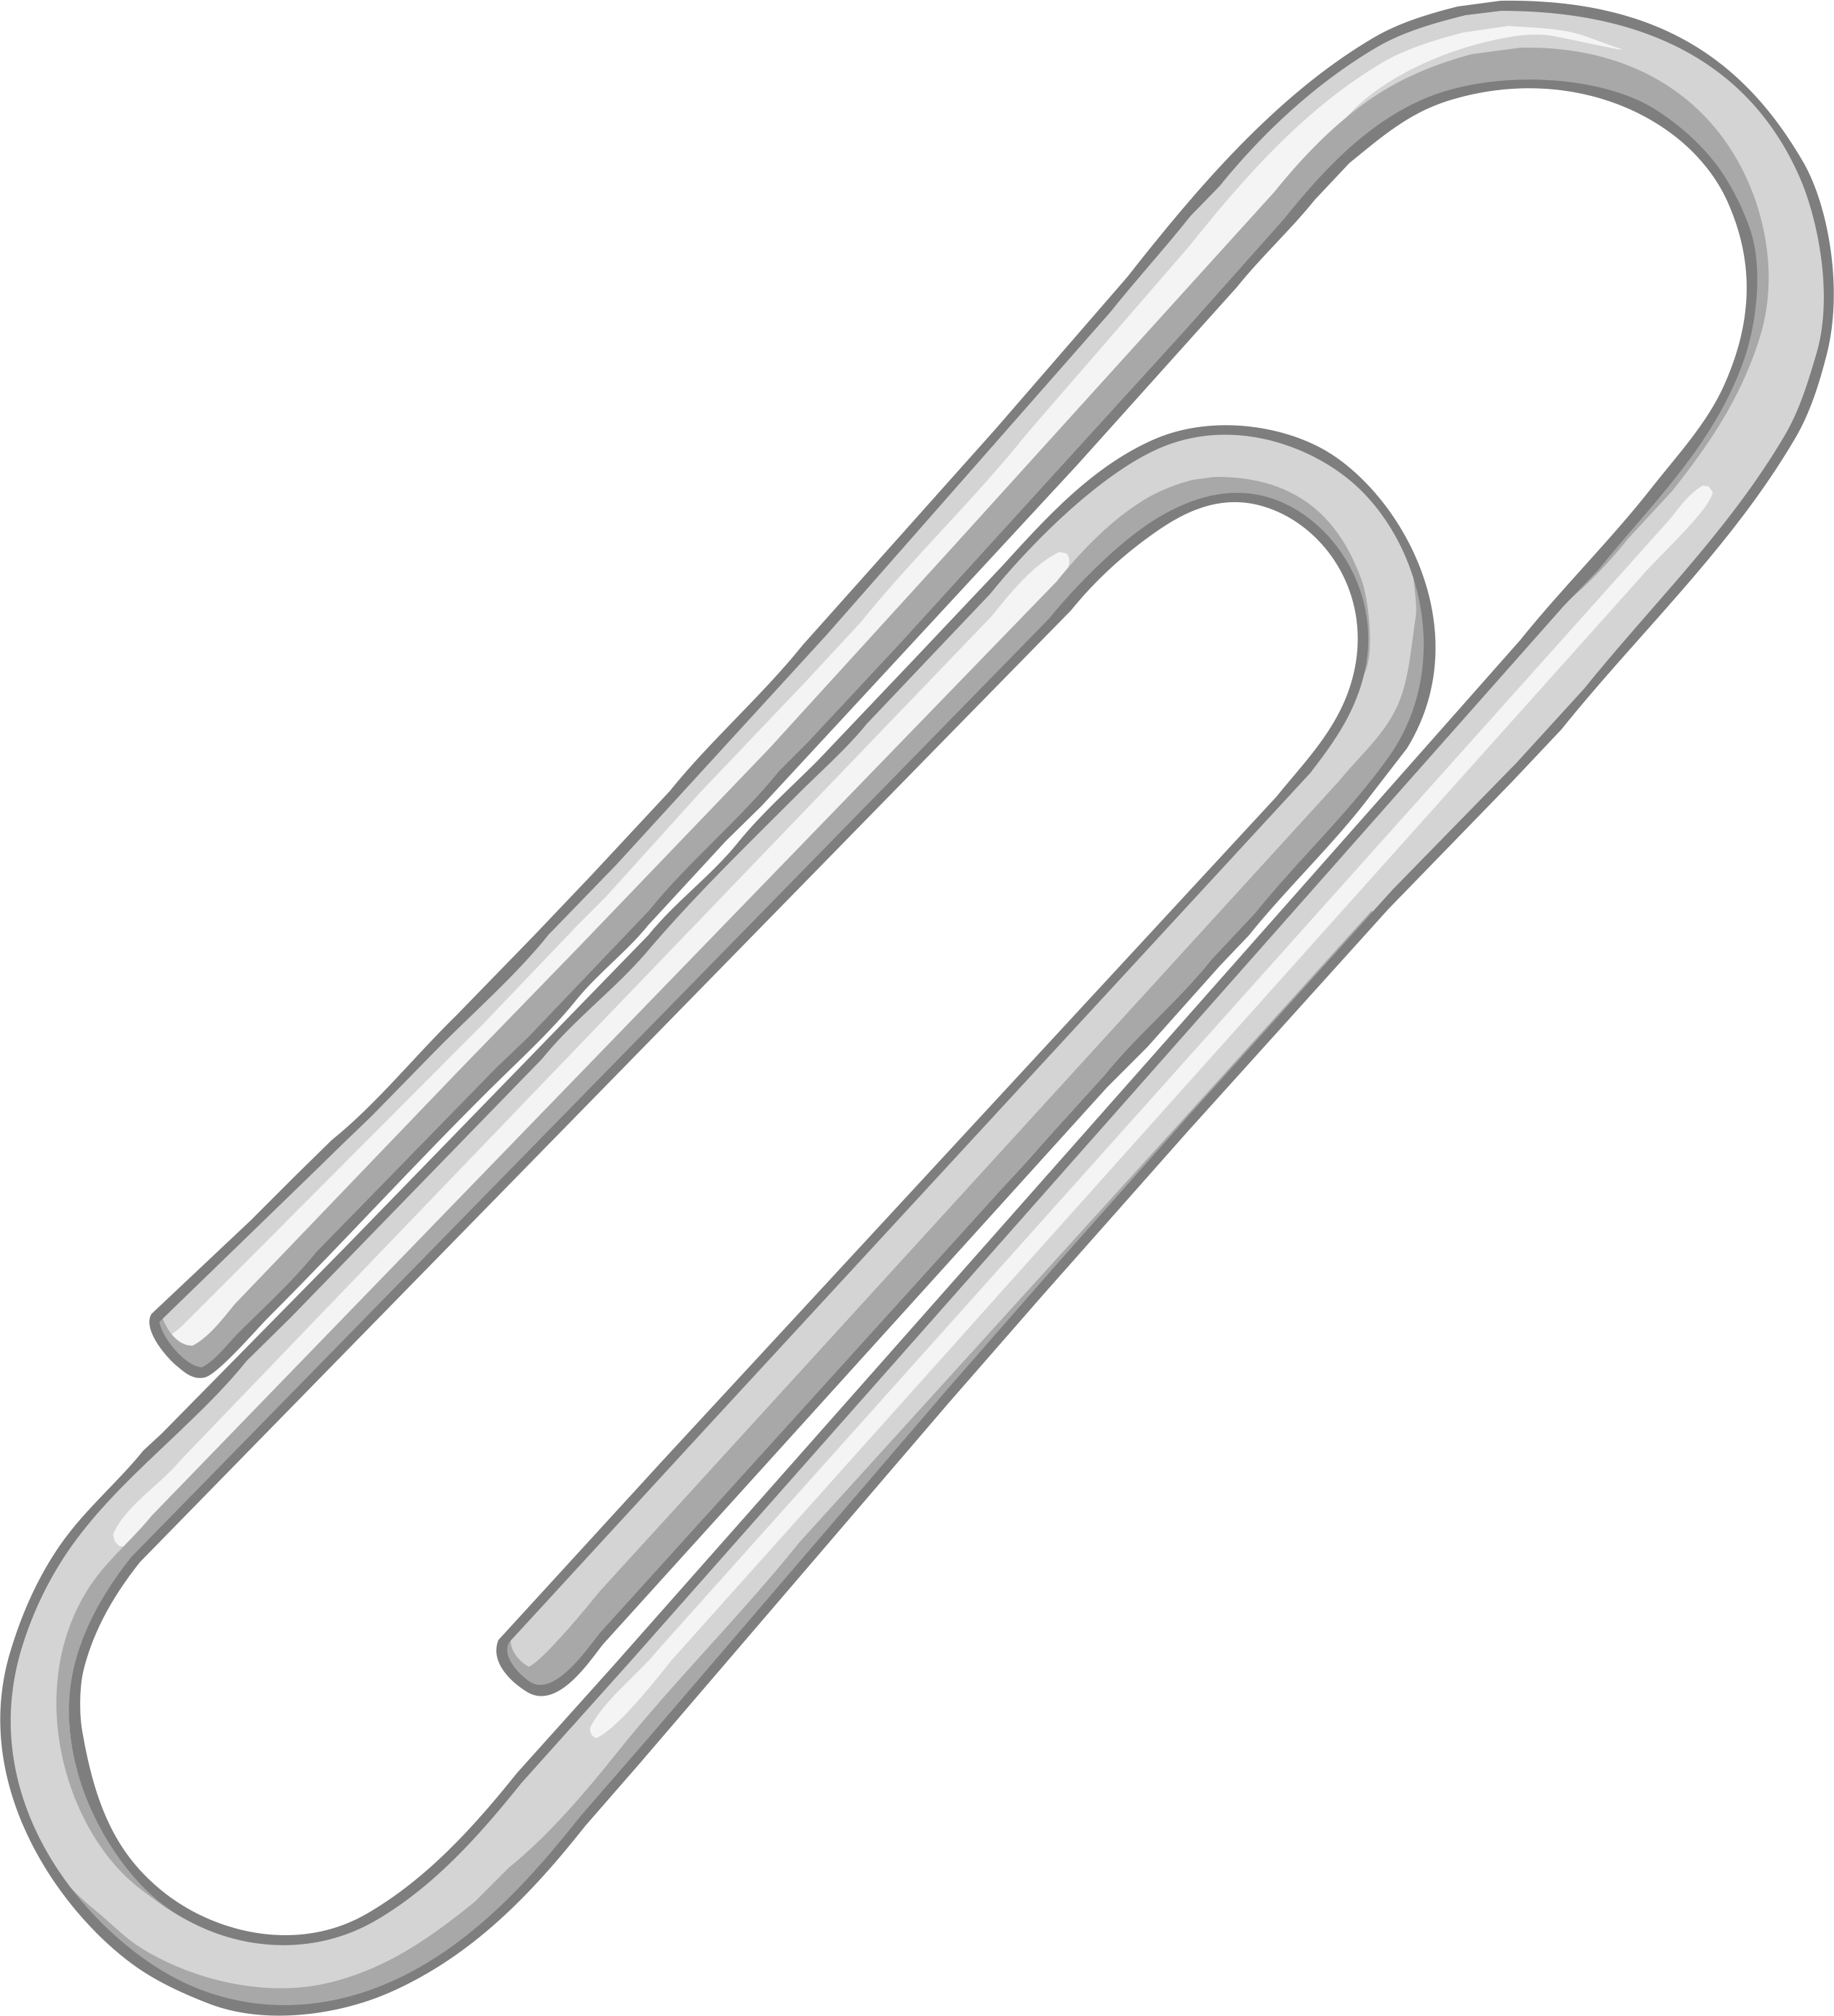
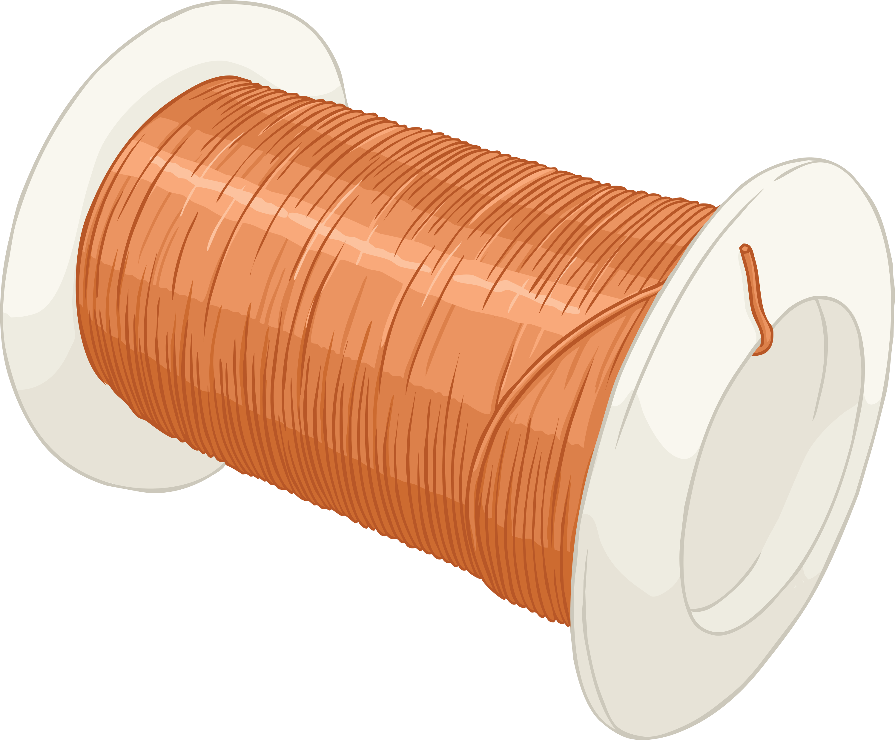
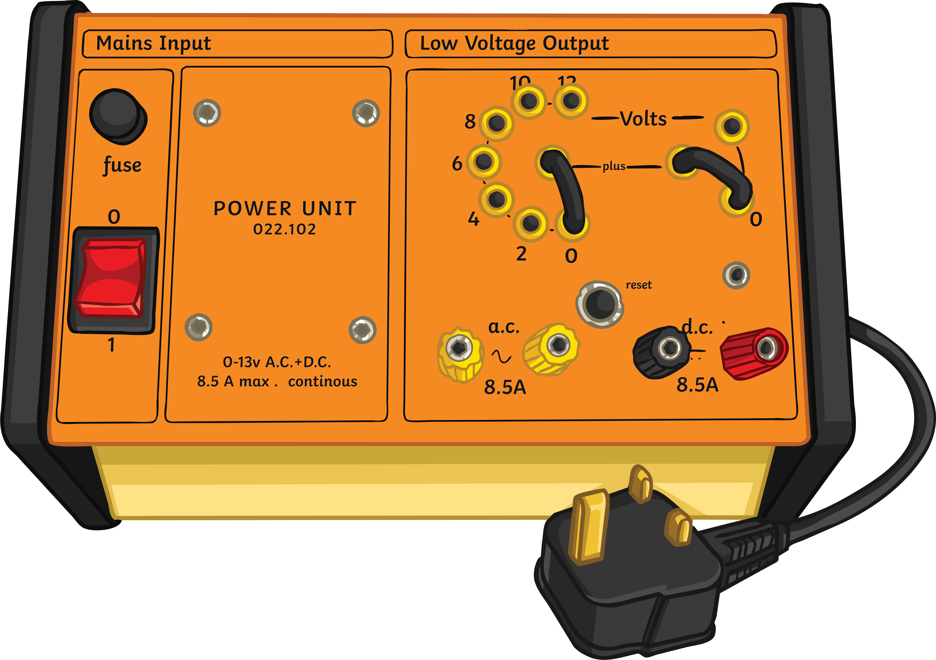
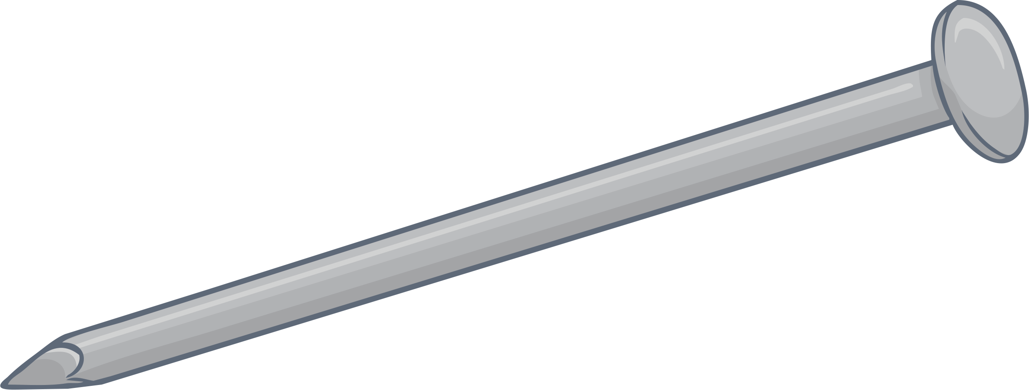
The Investigation
You are currently working as a mechanical engineer for a local scrap yard company.
The electromagnet that the scrap yard uses to lift the cars into the scrap machine has broken. The company think that the electromagnet isn’t strong enough and suspect it may be due to the lack of wire coils. The company needs to use the electromagnet to lift as many cars as they can in the shortest time possible.
Your task is to make a simple electromagnet to help you work out how to fix the company’s problem. You will use paperclips instead of cars. Remember, you need to make an electromagnet that can lift the most paperclips.
You have been given the following equipment –
how could you use it to make an electromagnet?
crocodile clip
paperclip
nail
copper wire
power pack

Slide 7
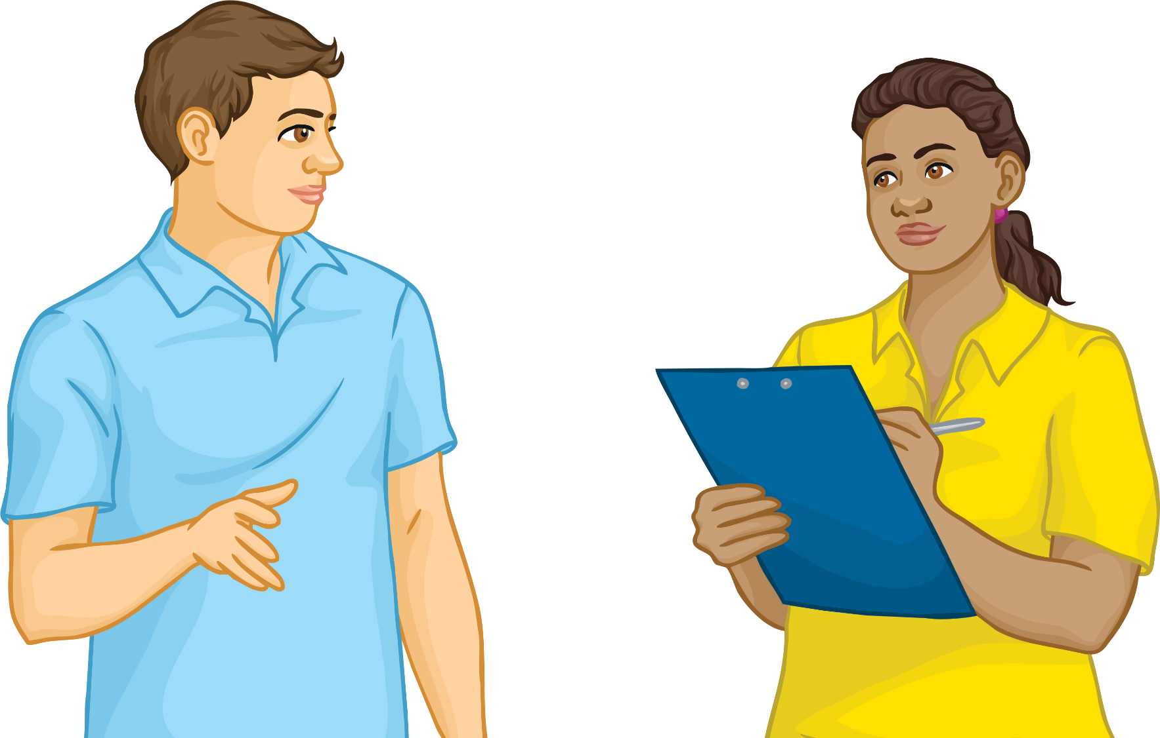
Core Practical Investigation
What is the aim of the investigation?
Make a prediction about what you think might happen. Will the number of coils affect the number of paperclips attracted to the electromagnet?
When writing a method, remember to make each step as clear as possible. Imagine that you are going to give the method to a teacher who has no knowledge of the subject. Could the teacher repeat the method based on your instructions?

Slide 8
Safety
Before carrying out any practical, a risk assessment must always be done.
What are the risks associated with this practical?
Hazard | Risk | Emergency Procedure
electricity | electric shock | Inform an adult in the room immediately.
copper wire | Sharp – could cut the skin. | Inform an adult in the room immediately.
power pack | Very heavy – could fall off the bench and land on somebody’s foot. | Inform an adult in the room immediately.

Slide 9

The Investigation Method
In your groups, you will need to collect the following pieces of equipment:
1 power pack, 1 large nail, 30cm of insulated copper wire, 2 crocodile clips, 2 wires and 30 paperclips.
Step 1 – Collect the equipment.
Step 2 – Place the crocodile clips on two of the wires.
Step 3 – Attach the opposite end of each wire onto the power pack.
Step 4 – Wrap the copper wire around the nail until you reach the
required number of coils. Use a pair of wire strippers to remove
some of the insulation. Leave 2cm of exposed wire at each end of
the copper wire.
Step 5 – Attach the crocodile clips to the exposed wire.
Step 6 – Lay the paperclips on the bench and hold the insulated wire either
side of the nail.
Step 7 – Hover the nail over the paperclips and record in your table how
many paperclips are attracted to the nail.

Slide 10
Conclusion
What did you find out from the practical investigation?
Remember, when writing a conclusion, use examples from your results to support your written work.
For example:
From my results, I found out that the red car on the smooth surface went the fastest.
From my results, I found out that the red car on the smooth surface went faster than the blue car on the rough surface.
From my results, I found out that the red car on the smooth surface went faster than the blue car on the rough surface. On average, the red car was two seconds faster than the blue car which had an average of five seconds.
What are the good and bad points about each example?

Slide 11
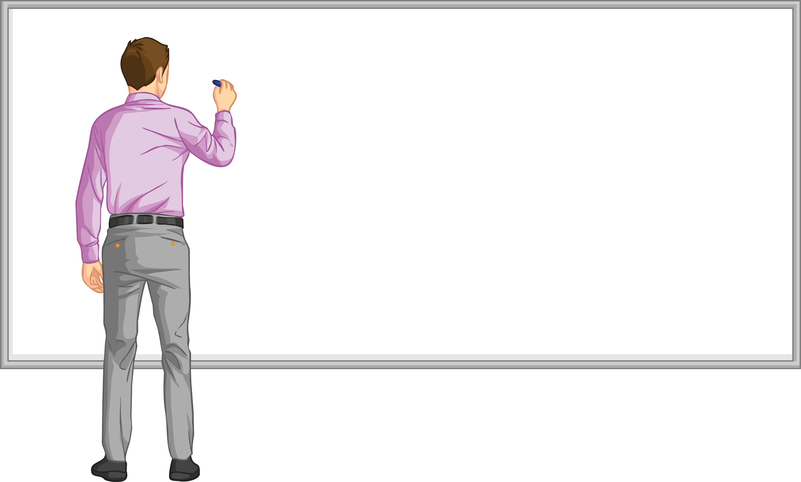
Evaluation
How could you improve the practical for next time?
What was the biggest difficulty you had with this experiment and how
could you overcome it?
What would be the advantage of comparing your results with other people’s?

Slide 12
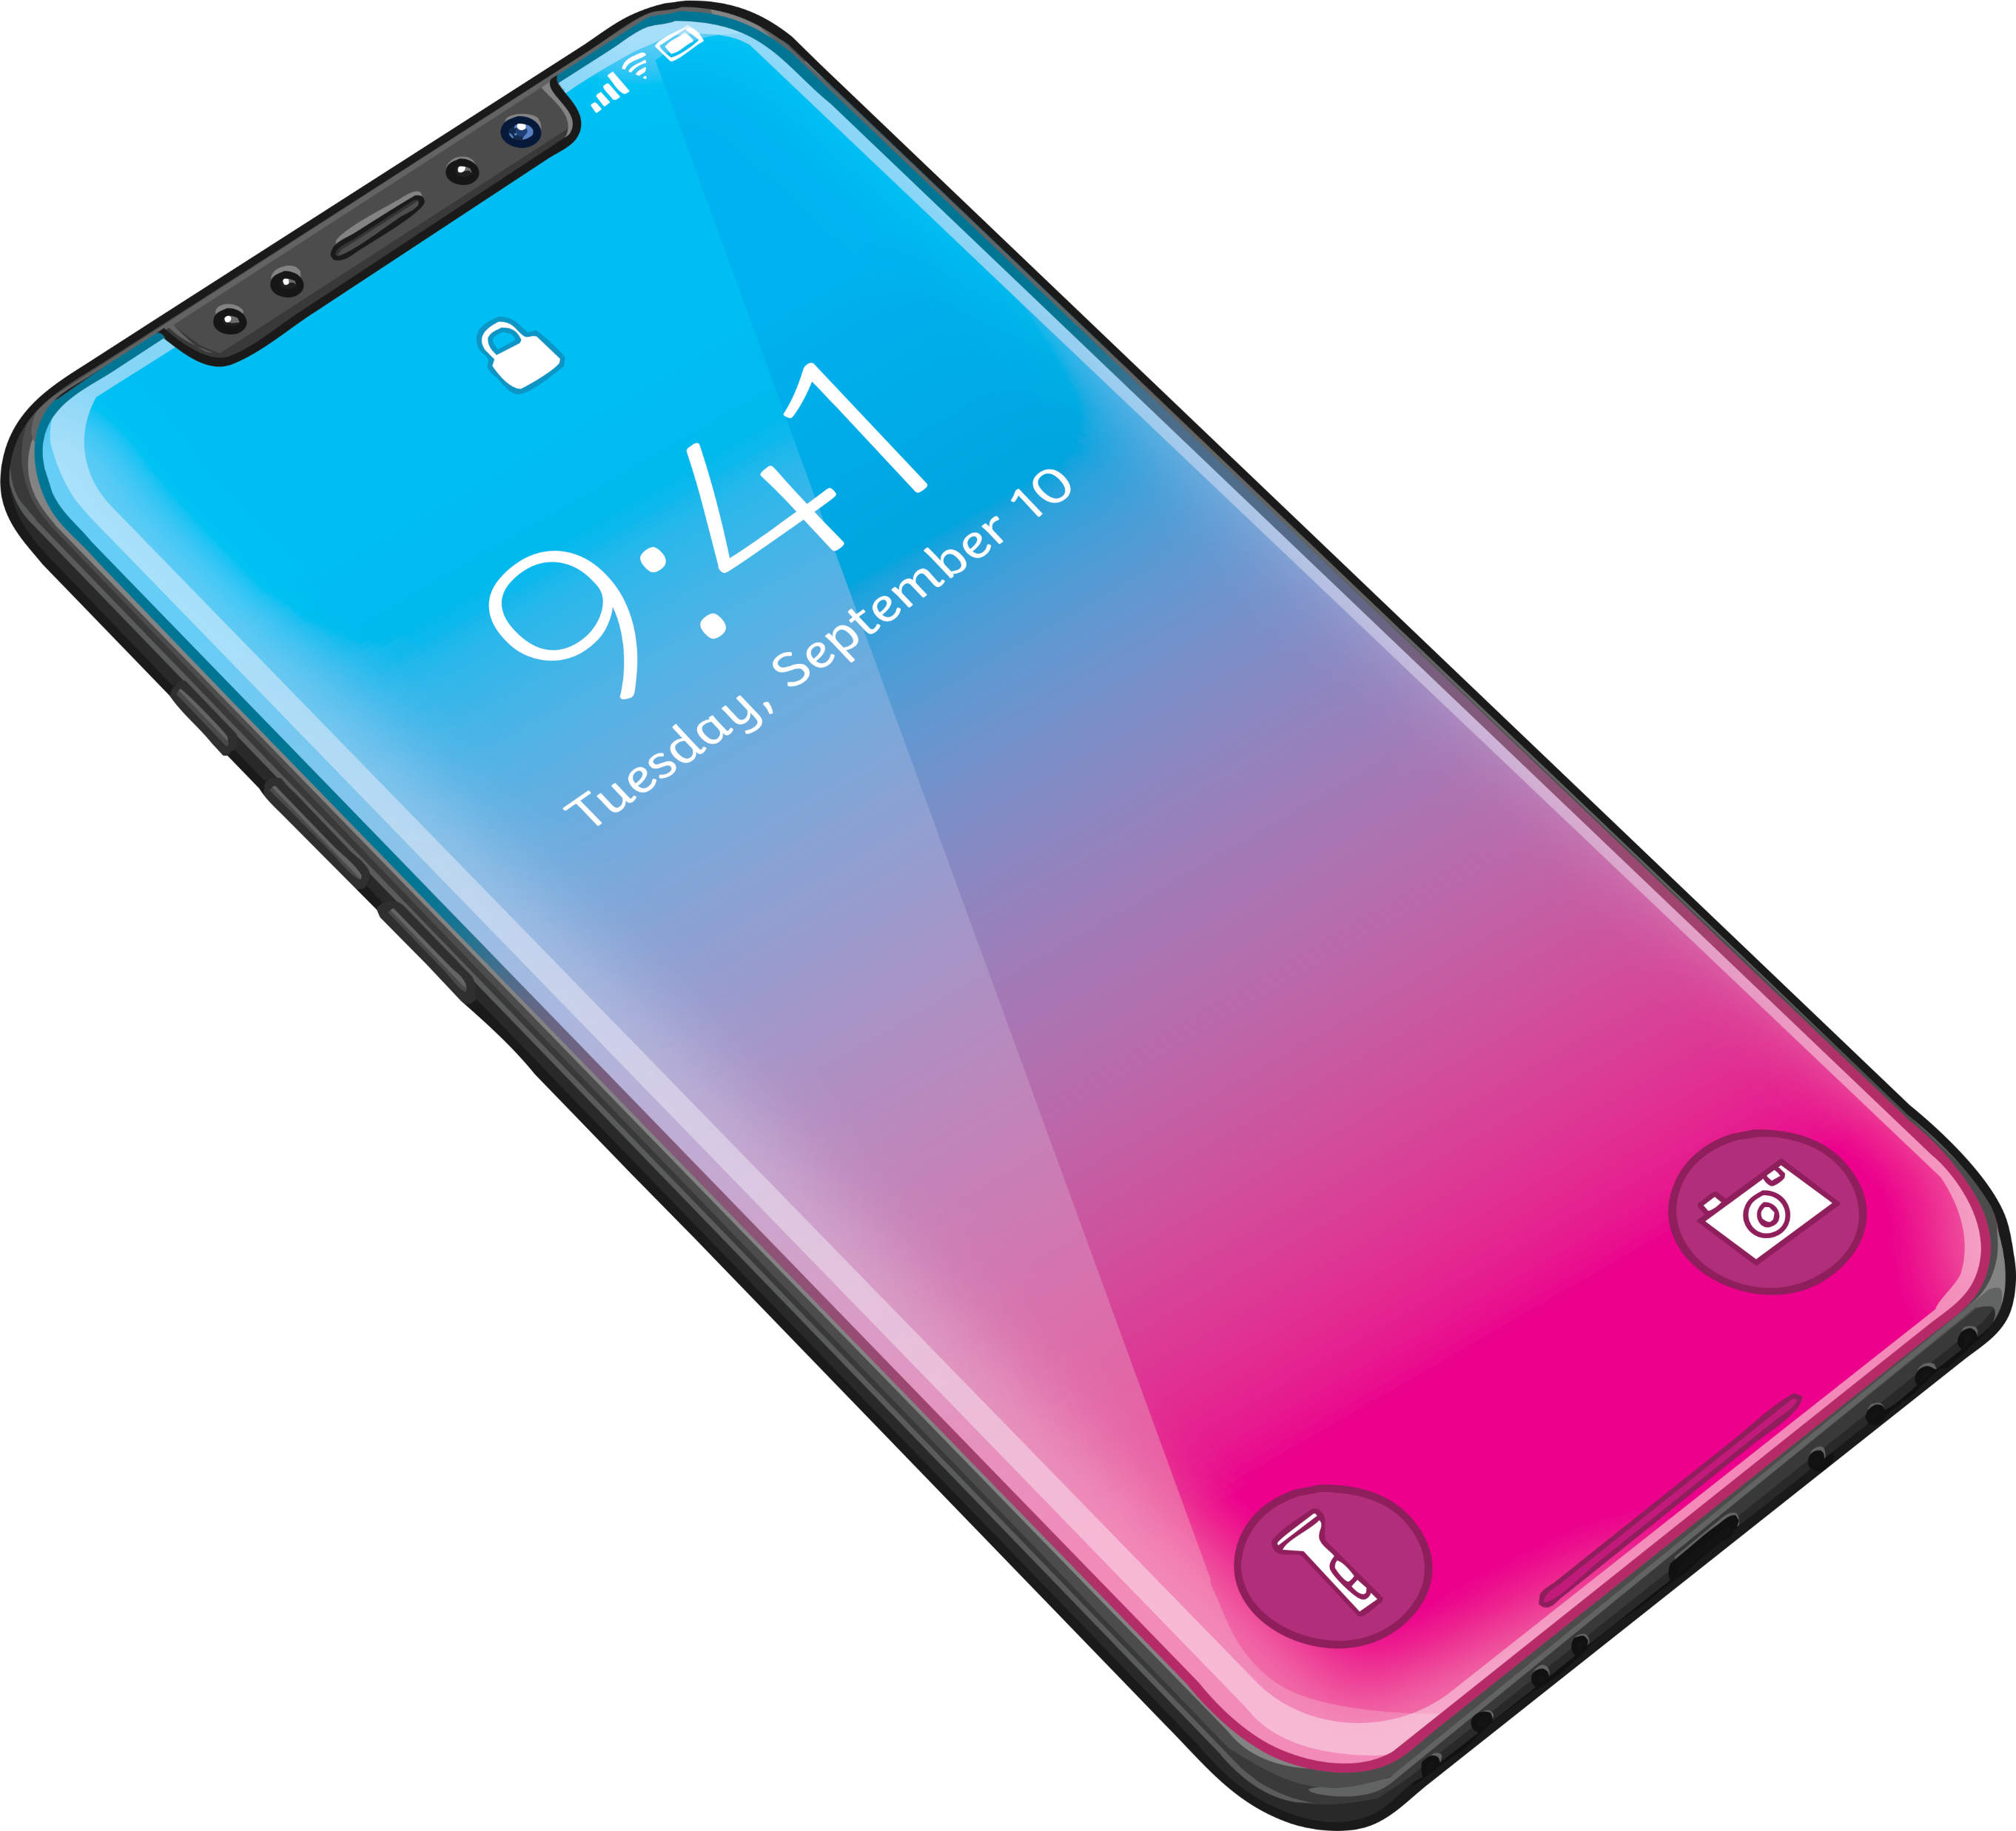
Plenary: Tweet Me!
What have you learnt this lesson?
Write two old-style, 140-character Tweets. One for things that you have done well this lesson; one for things that you need to improve for next lesson.
Remember, spaces and punctuation count as characters!

